Slide 1
Reconstruction
What happened after the Civil War?

Slide 2
It’s Friday, a little after 10:00p.m. President Abraham Lincoln and his wife, Mary are enjoying a play. The President and his guests are seated in a box above the stage of Ford’s Theatre.
Suddenly, the audience hears something like an explosion. Blue-colored smoke comes from the box where the President is seated. Mary Lincoln screams. President Lincoln has been shot. The bullet has entered the back of his head near his left ear. Lincoln is still breathing but unconscious.
A young doctor comes forward to aid the President. After checking his wound, he says, “It is impossible for him to recover.”

Slide 3
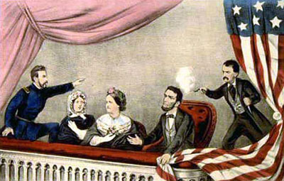
The Assassination of
President Lincoln

Slide 4
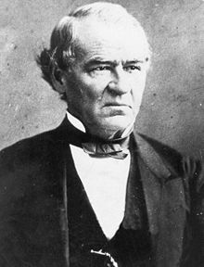
Reconstruction
After Lincoln was assassinated
by John Wilkes Booth,
Vice President Andrew Johnson
became the president.
He continued Lincoln’s plan of
RECONSTRUCTING the United
States after the Civil War

Slide 5
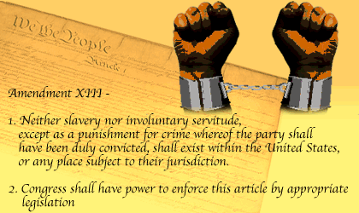
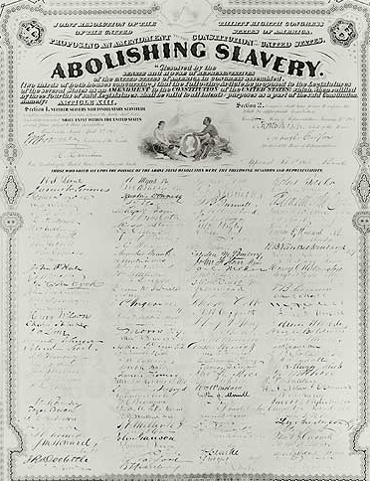
13 Amendment
What do you observe?
What was the purpose of the 13th amendment?
What does this mean for African Americans?

Slide 6
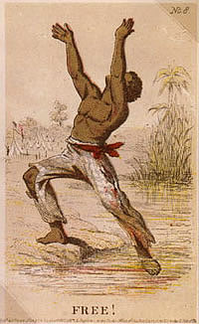
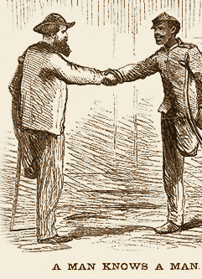
14 Amendment
What do you observe?
What was the purpose of the 14th amendment?
What does this mean for African Americans?

Slide 7
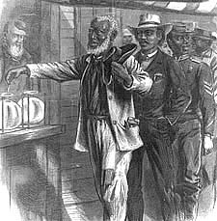
15 Amendment
What do you observe?
What was the purpose of the 15th amendment?
What does this mean for African Americans?

Slide 8
FORMER SLAVES SEEM TO HAVE A LOT OF RIGHTS…
13th Amendment: slavery is abolished
14th Amendment: former slaves are citizens
15th Amendment: African American men have the right to vote
Do you think former slaves were treated equally in the United States?
By Northerners?
By Southerners?

Slide 9
Black Codes
These were laws passed in the south preventing former slaves from freedoms…
Could not own land
Could not own a gun
Could not have certain jobs
Could not be on a jury
Draw what you think this looks like
How do you think this made former slaves feel?
ILLEGAL

Slide 10
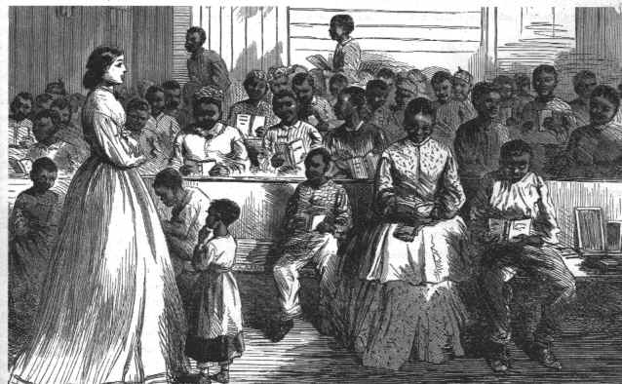
AS A RESULT OF BLACK CODES
BEING ILLEGAL …
Congress passed new laws to protect former slaves
Freedman’s Bureau: designed to help former slaves
  Built schools and
  hospitals for African
  Americans
  Hired teachers
  Helped former
  slaves find jobs

Slide 11
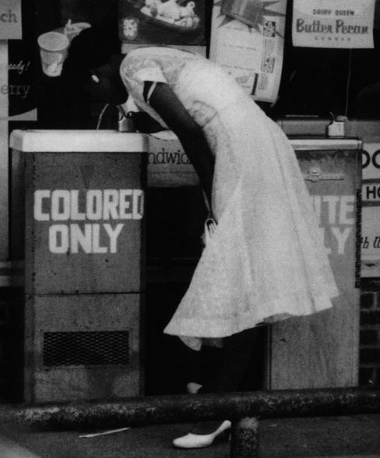
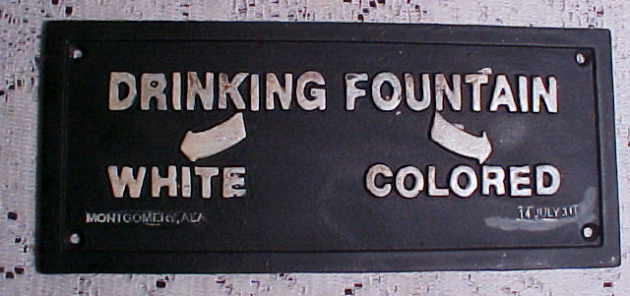
THIS SOUNDS GREAT…EVERYONE IS BEING TREATED EQUALLY…
Not everyone agreed…
Segregation (the separation of blacks
and whites) became common

Slide 12
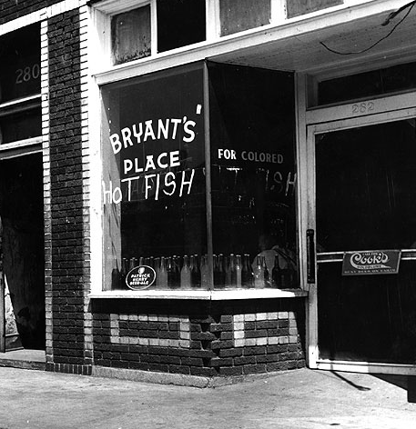
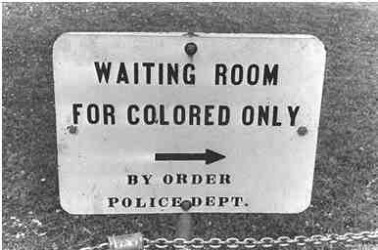
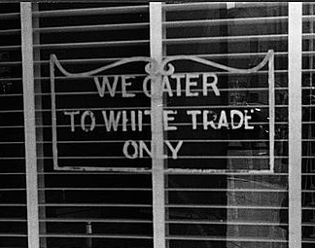
What do you see?

Slide 13
AS A RESULT OF TENSIONS BETWEEN BLACKS AND WHITES…
Jim Crow Laws were passed:
  These laws enforced segregation (the separation of blacks and whites)
  Under these laws, blacks could not:
        Sit with white people on buses, trains, etc.
        Go to school with white people
        Share water fountains, bathrooms, etc. with white people
        Eat at certain restaurants
  What do you think this situation created?

Slide 14
what did slaves do for work?
What do they know how to do?
Can they read?
Are they educated?
As a result, they had to do what they know…

Slide 15

Freed men…
Had no money to purchase land
Little opportunity to work for wages since little currency was available in the South
Entered into agreements with land owners to trade labor for land in an arrangement known as Sharecropping
Sharecropping - in exchange for the right to work the land, poor whites and African Americans would be given a share of the crop they grew.

Slide 16
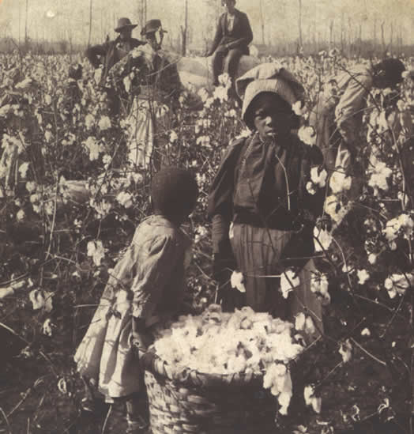
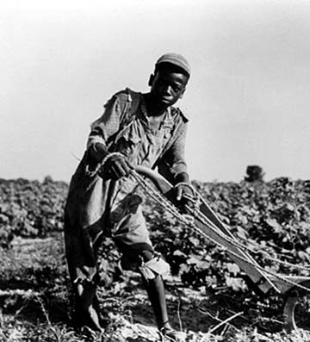
What do you see?

Slide 17

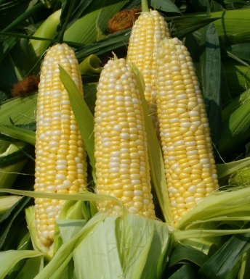
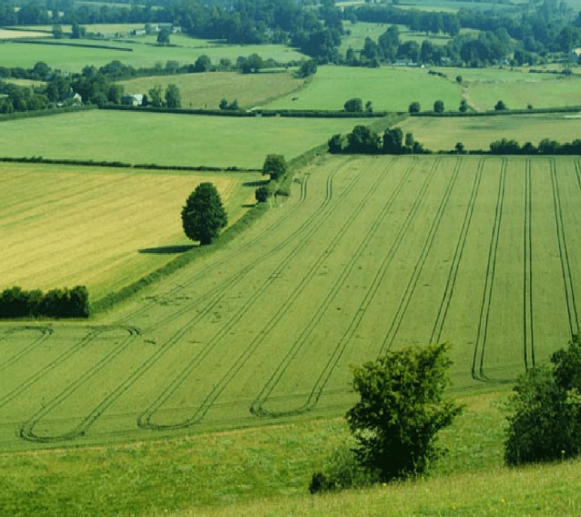
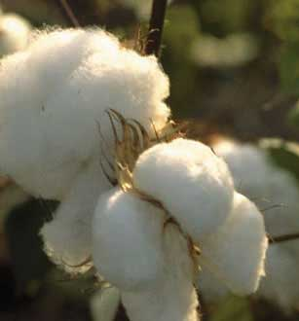

Sharecropping
A LOT of money for the land owners
Little to no money left for the former slave to by food, clothing, etc. for his family.
Former slaves rented land from landowners
To pay rent, they had to give most of their crops to the landowner.

Slide 18
Freedman’s Bureau
Established before the end of the Civil War
Bureau was never effectively staffed or funded.
First line of assistance to ALL people in the South in need
What did it do?
Provided food, clothing, medical care, education and protection from the hostile white environment in the South
Helped freemen find jobs and protection of their labor contracts
However, African Americans were not able to achieve economic independence because they were not allowed to have their own land to farm, so the Freedman’s Bureau helped to build relationships with worker-less plantation owners with African Americans to establish sharecropping
The biggest contribution of the Bureau would be the establishment of over 1,000 schools throughout the South

Slide 19
Do you think the freedman’s bureau helped? Why or why not?

Slide 20

Acquiring Land…
Acquire – to get
Most African Americans tried, but for the most part, it was _________________.
General Sherman advocated distribution of “forty acres and a mule” to African American war refugees and some land was distributed during and shortly after the Civil War.
Later, the federal Government returned most lands to white landowners that had been confiscated from the Confederates and given to freedman.

Slide 21
Does sharecropping remind you of anything?
Slavery
Sharecropping

