Slide 1
Building a Skyscraper Strong Enough to Withstand an Earthquake Task

Slide 2
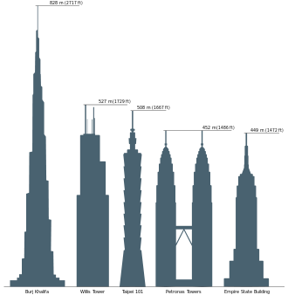
INTRODUCTION Because earthquakes can cause walls to crack, foundations to move and even entire buildings to crumple, engineers incorporate into their structural designs techniques that withstand damage from earthquake forces, for example, cross bracing, large bases and tapered geometry. Earthquake-proof buildings are intended to bend and sway with the motion of earthquakes, or are isolated from the movement by sliders. Engineers come up with an idea, test it, and then re-engineer the structure based on its performance.

Slide 3
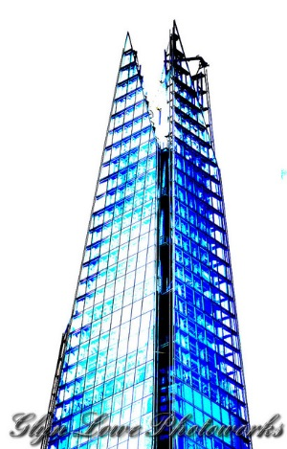
Task Card 1 Read the following problem you and your team needs to solve: The Problem: You will be acting as a civil engineer. You will be part of a team that will make a model of a building and conduct an experiment to test how well your company’s structure stands up under the stress of an earthquake. Your company is spending billions of dollars on this project, so you need to come up with a good design!

Slide 4
Task Card 2 – Background Information
Directions: Read the background information below to start your research process.
Earthquakes can cause much loss of life and millions of dollars worth of damage to cities. Surface waves and body waves from earthquakes can cause walls to crack, foundations to move and even entire buildings to crumble. Engineers continually strive to make buildings stronger to resist the forces of earthquakes.
Engineers face the challenge of designing more robust buildings to withstand earthquakes. Earthquake-proof buildings are intended to bend and sway with the motion of earthquakes, instead of cracking and breaking under the pressure.
Questions to discuss with your team:
1.) Have you ever looked at a really tall building, such as a skyscraper? What does it look like?
2.) Does it appear fragile and unstable? It might, but it is most probably quite sturdy and can withstand wind, rain and other natural elements and phenomena. Earthquake-proof buildings typically have cross bracing that forms triangles in its design geometry (like a bridge). Such buildings also typically have a large "footprint," or base, and a tapered shape, decreasing in size as the building gets taller (or simply, smaller at the top). Short buildings are more earthquake proof than tall ones. Why do you think that is?
3.) Have you ever climbed up a tree or been on top of a playground jungle gym in the wind? Do you sway more when you are up high than when on the ground? All buildings shake at the same frequency as the shaking of the Earth, but the movement is magnified as the building gets taller. Sometimes, as can be the case during earthquakes, buildings sway too much, crack and crumble and fall.

Slide 5
Task Card 3 – Research to Get You Started Use the links below to explore the topics of earthquakes and/or skyscraper design/history: 1.) https://safari.fultonschools.org/?p=7202c706-7694-11e5-b88a-90e2ba6a02fc 2.) http://www.iris.edu/hq/files/programs/education_and_outreach/retm/tm_100112_haiti/BuildingsInEQs.pdf 3.) http://imaginationstationtoledo.org/content/2011/03/can-you-build-an-earthquake-proof-building/ Discuss the following questions with your team and do additional research if needed: * What criteria do you think is important in skyscraper design in order to withstand an earthquake? * What has worked throughout history and what hasn’t? Which buildings have crumbled and why? How are they different from ones that have stayed standing during an earthquake?

Slide 6
Task Card 4: Project Requirements
1.) Read steps 1-9 before you start anything!!!!
2.) Your team will be allowed 30 toothpicks and 30 marshmallows to use in your design. You can make cubes and triangles using toothpicks and marshmallows. You can break a toothpick approximately in half. Cubes and triangles are like building blocks that may be stacked to make towers. The towers can have small or large "footprints" (or bases).
3.) Your team will first need to create a design for your skyscraper on grid paper (like a blueprint) and have it approved. You will also need to include steps for your design.
4.) Then you will need to build your skyscraper with your team.
5.) Once built, your team will need to test it in a pan of Jello to see if it is earthquake proof.
6.) If it works, then you need to go back to your blueprint and label your shapes within your design with their proper geometric names. You will also need to measure its length, width, height, total volume, surface area, and measure its weight.
7.) If your design does not work, you will need to go back to the drawing board (literally) and redesign your blueprint on grid paper.
8.) Then you will need to rebuild it and retest it. If it works this time, now label the geometric shapes within your design. You will also need to measure its width and height along with measuring its weight.
9.) After two tests, you will prepare a digital presentation of your design process. Include within your presentation the following: 1.) Titles/subtitles
2.) Pictures with captions of your design, labeled blueprints, and steps in process
3.) Answers to the following questions: What worked in your design? What didn’t work? Why not?
How would you change your design to better withstand earthquakes? What are some important
reminders for other civil engineers to keep in mind when designing skyscrapers?

